Slide 1
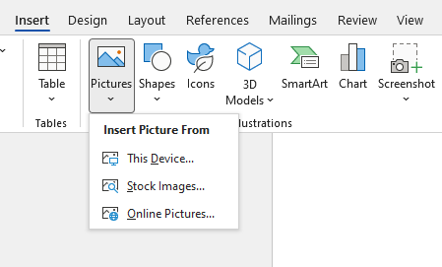
Inserting images, shapes, and icons
In the Illustrations Group
Icons / 3D Models – Visually rich elements.
Pictures – Insert from your computer.
Online Pictures – Search and insert from web.
Shapes – Add arrows, rectangles, etc.

Slide 2
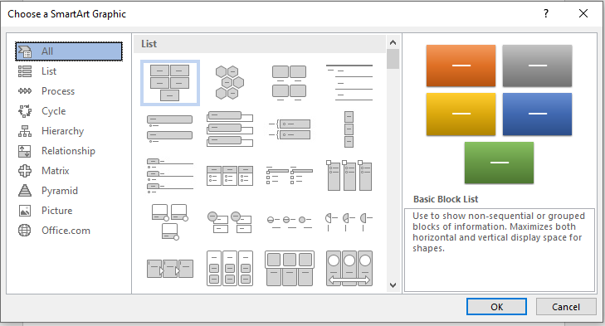
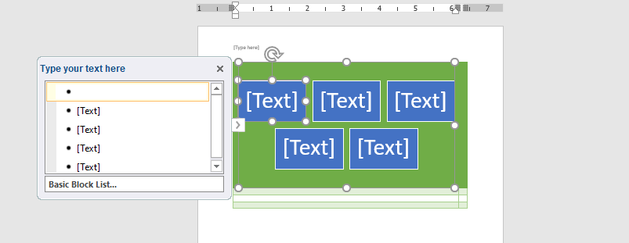
SmartArt – Insert diagrams for processes, hierarchy.
Visual data representation
Types: List, Process, Cycle, Hierarchy, Relationship

Slide 3
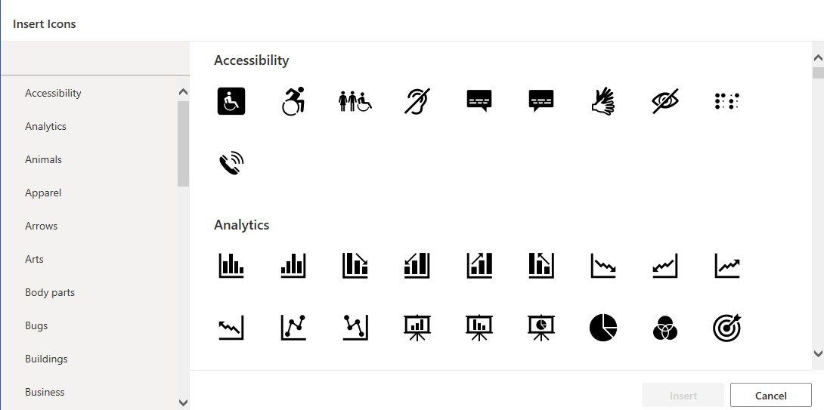

Slide 4
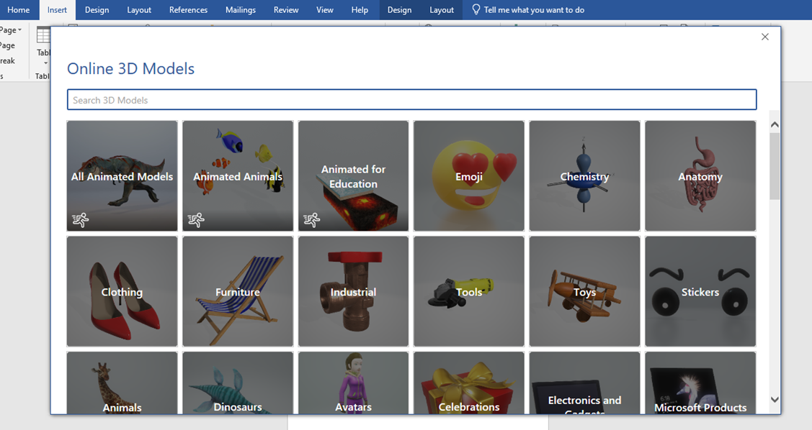

Slide 5
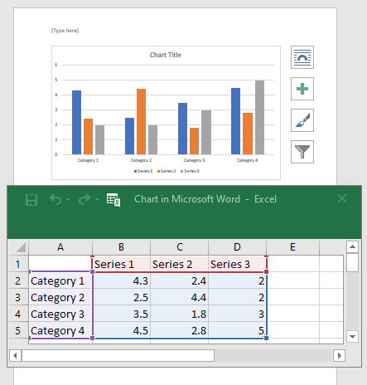
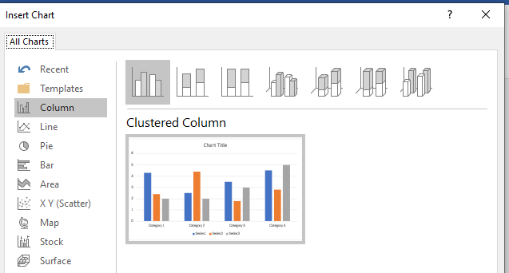
Charts
Types: Column, Line, Pie, Bar, Area
Used for data visualization
Editable via Excel

Slide 6
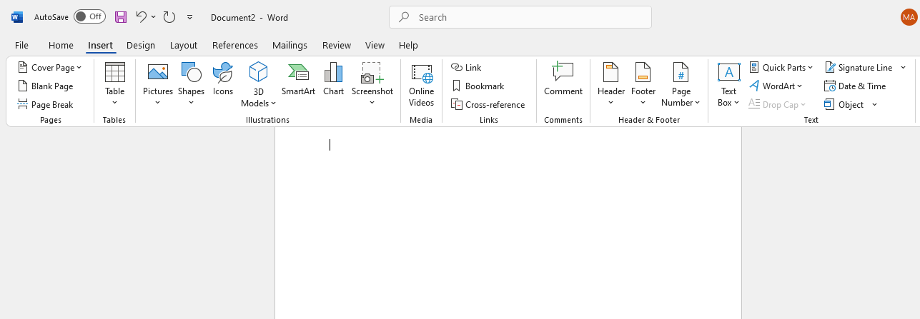

Slide 7
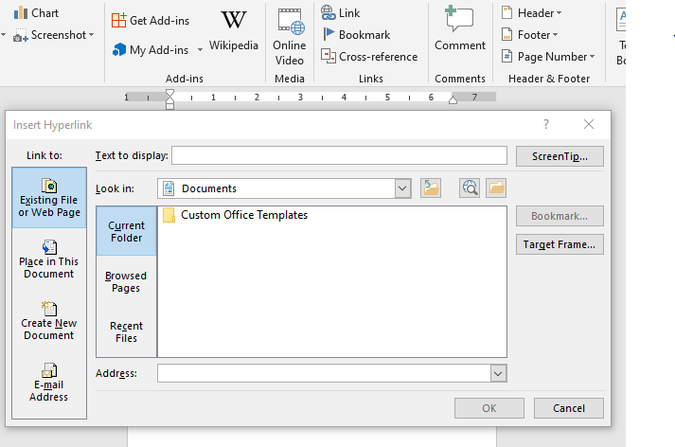
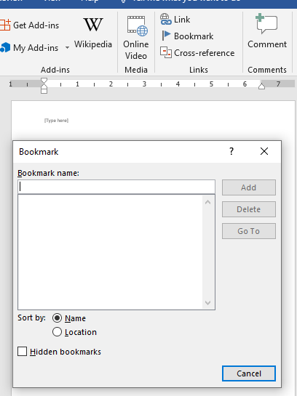
Links Group
Hyperlink: Link to web or doc
Bookmark: Mark a location

Slide 8
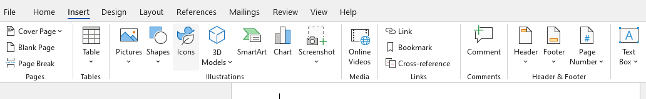
Working with Header, Footer & Page Number
Header/Footer: Top & bottom info
Page Number: Insert with formatting
Click on insert tab
Choose Header, Footer and Page number

Slide 9
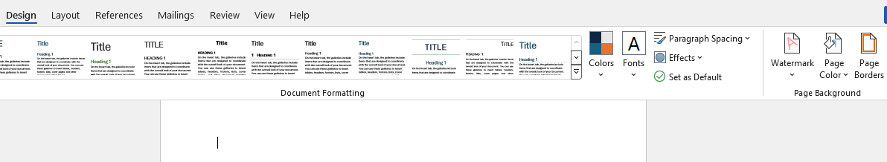
For watermark
Click on the design tab
In the page background select background

Slide 10
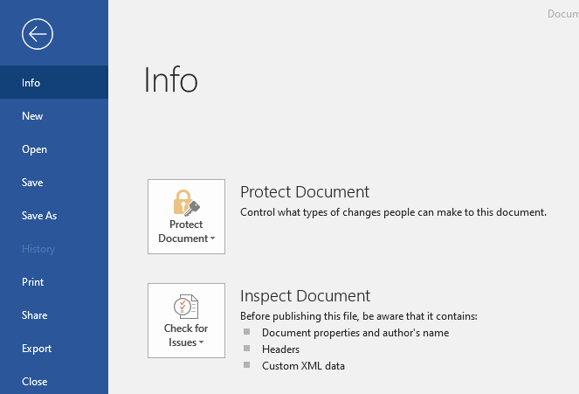
How to save a file in msword
Click on the File Tab The File tab is located at the top-left corner of the MS Word window. Clicking it opens the backstage view, where file-related options are available.

Slide 11
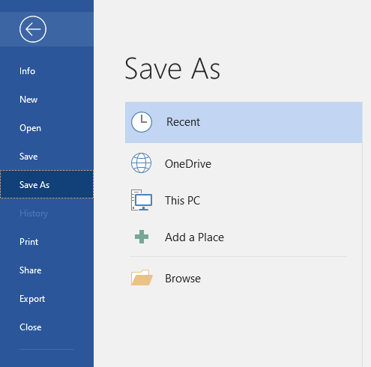
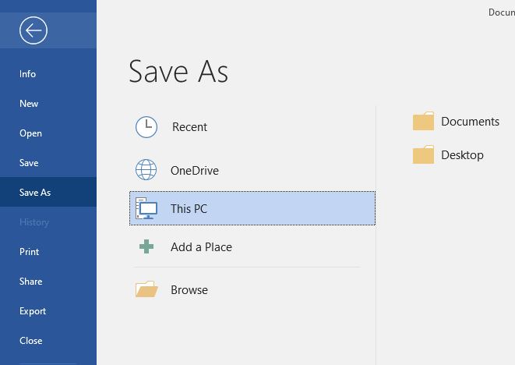
Choose 'Save’:
Updates the existing file (useful for ongoing work).
Choose 'Save As:
Save As: Lets you create a new file with a different name or format

Slide 12
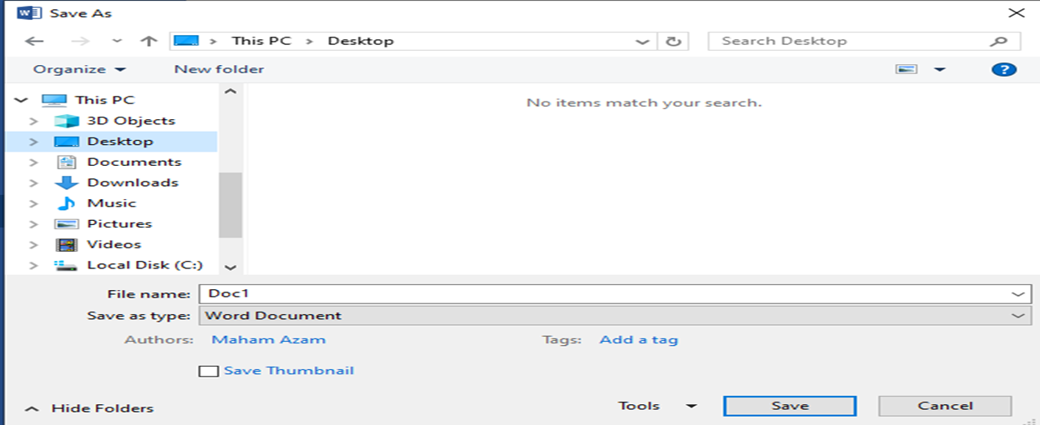
Enter a File Name
Type a meaningful name so you can recognize the file easily later.
Select File Format
Common formats:
.docx (default Word document) .pdf (for sharing or printing).txt (plain text)
Click the Save’
Button Once everything is selected (name, location, format), click Save.
Your file is now stored and can be reopened anytime.

Slide 13
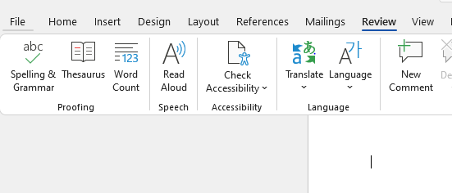
Proofing Tools: Spelling, Grammar & Thesaurus
Click on Review tab
click on spelling and grammar
Click on thesaurus

Slide 14
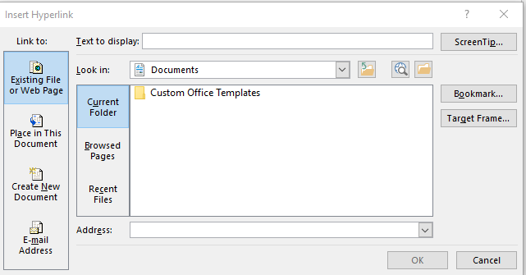
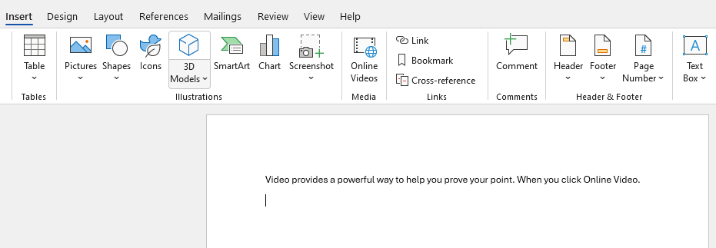
Hyperlink
Click on insert tab
Click on Hyperlink
Add text here
Add address here

Slide 15
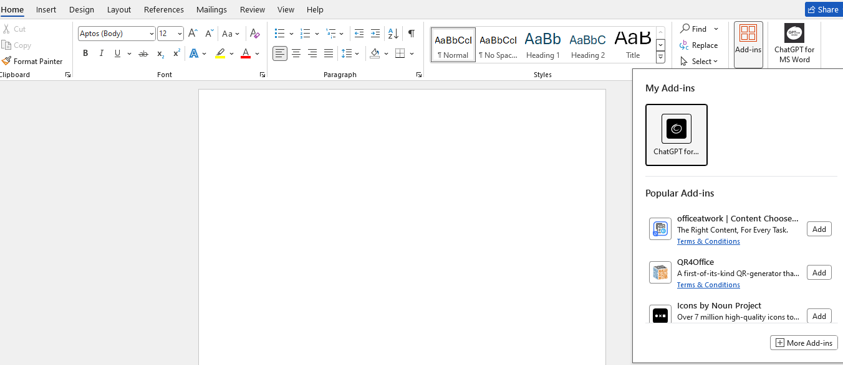
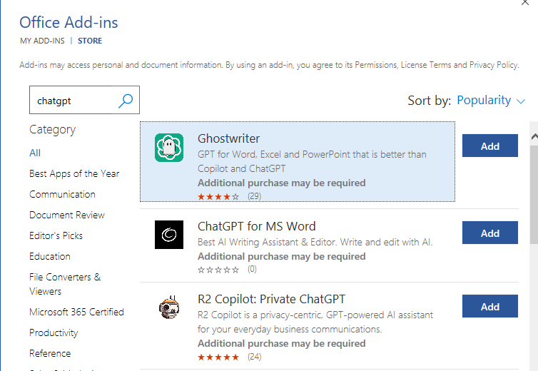
Integrating AI tools in Word
Click on Home tab
Click on
Add-ins
Type here
Click on
More Add-ins
Click add

Slide 16
Click

